Slide 1
R Consortium: Striving to Address Diversity Issues in Open Source
David Smith, R Consortium Gabriela de Queiroz, R Consortium

Slide 2
The R Consortium
A Linux Foundation Collaborative Project supporting the R Community
Founded June 2015 in partnership with R Foundation with a focus on:
Use of R for commercial applications
Funding and support of of community-led projects
Expanding and supporting the community of R users

Slide 3
Supporting the R Community
In addition to funding technical projects, the R Consortium funds programs to support the R community generally.
R User Group support program
SatRdays meetups
Diversity Working Group
R-Ladies
Community Survey

Slide 4
The R Community Survey
Survey of R users Worldwide
29 survey questions provided in English, Spanish and Chinese
Opened July 1, 2017; closed Aug 31, 2017
3618 Responses
98% of respondents reported using R
2% of respondents used R in the past, or planned to in future
Many verbatim (free-text responses)
Lots of interesting feedback!

Slide 5
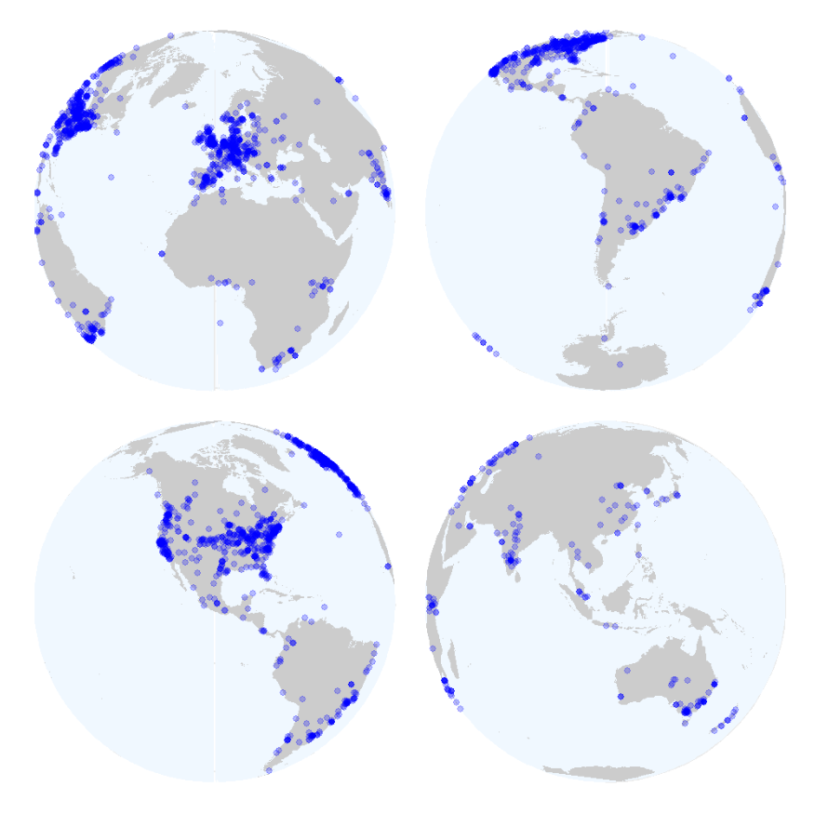
Where did the responses come from?
1616 respondents selected their location on an interactive map

Slide 6
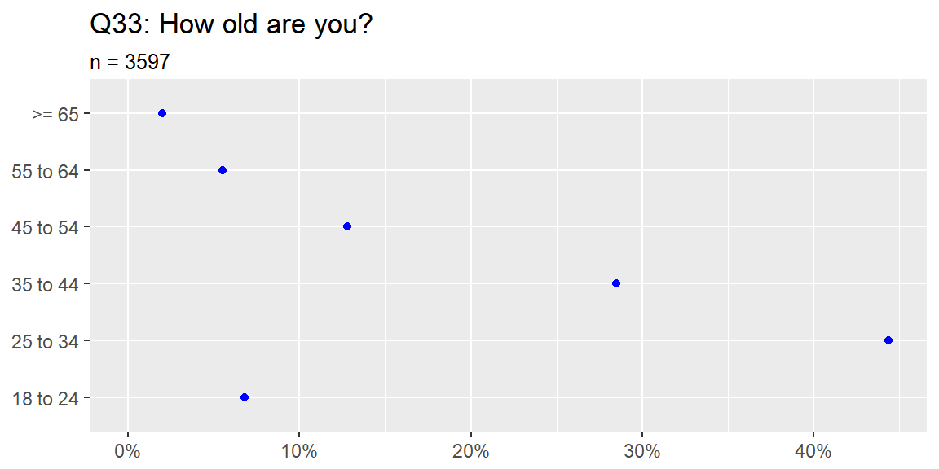
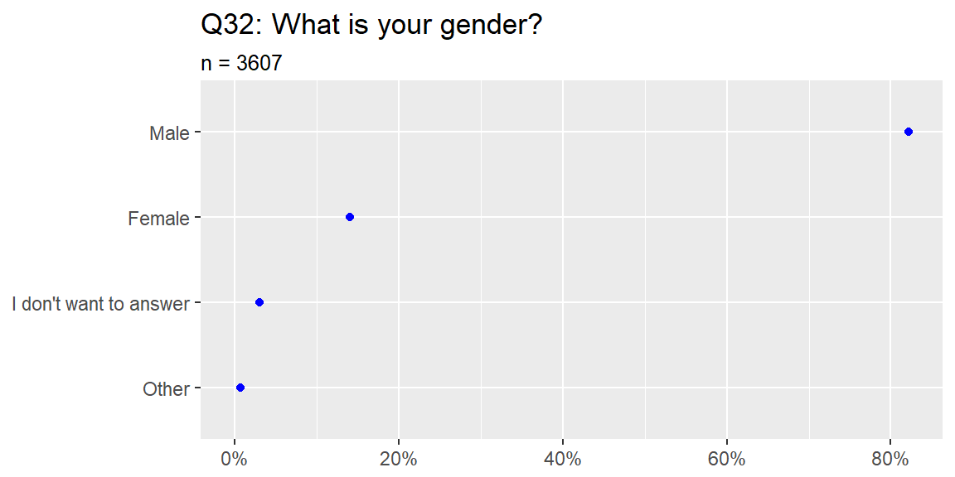
Demographics of respondents

Slide 7
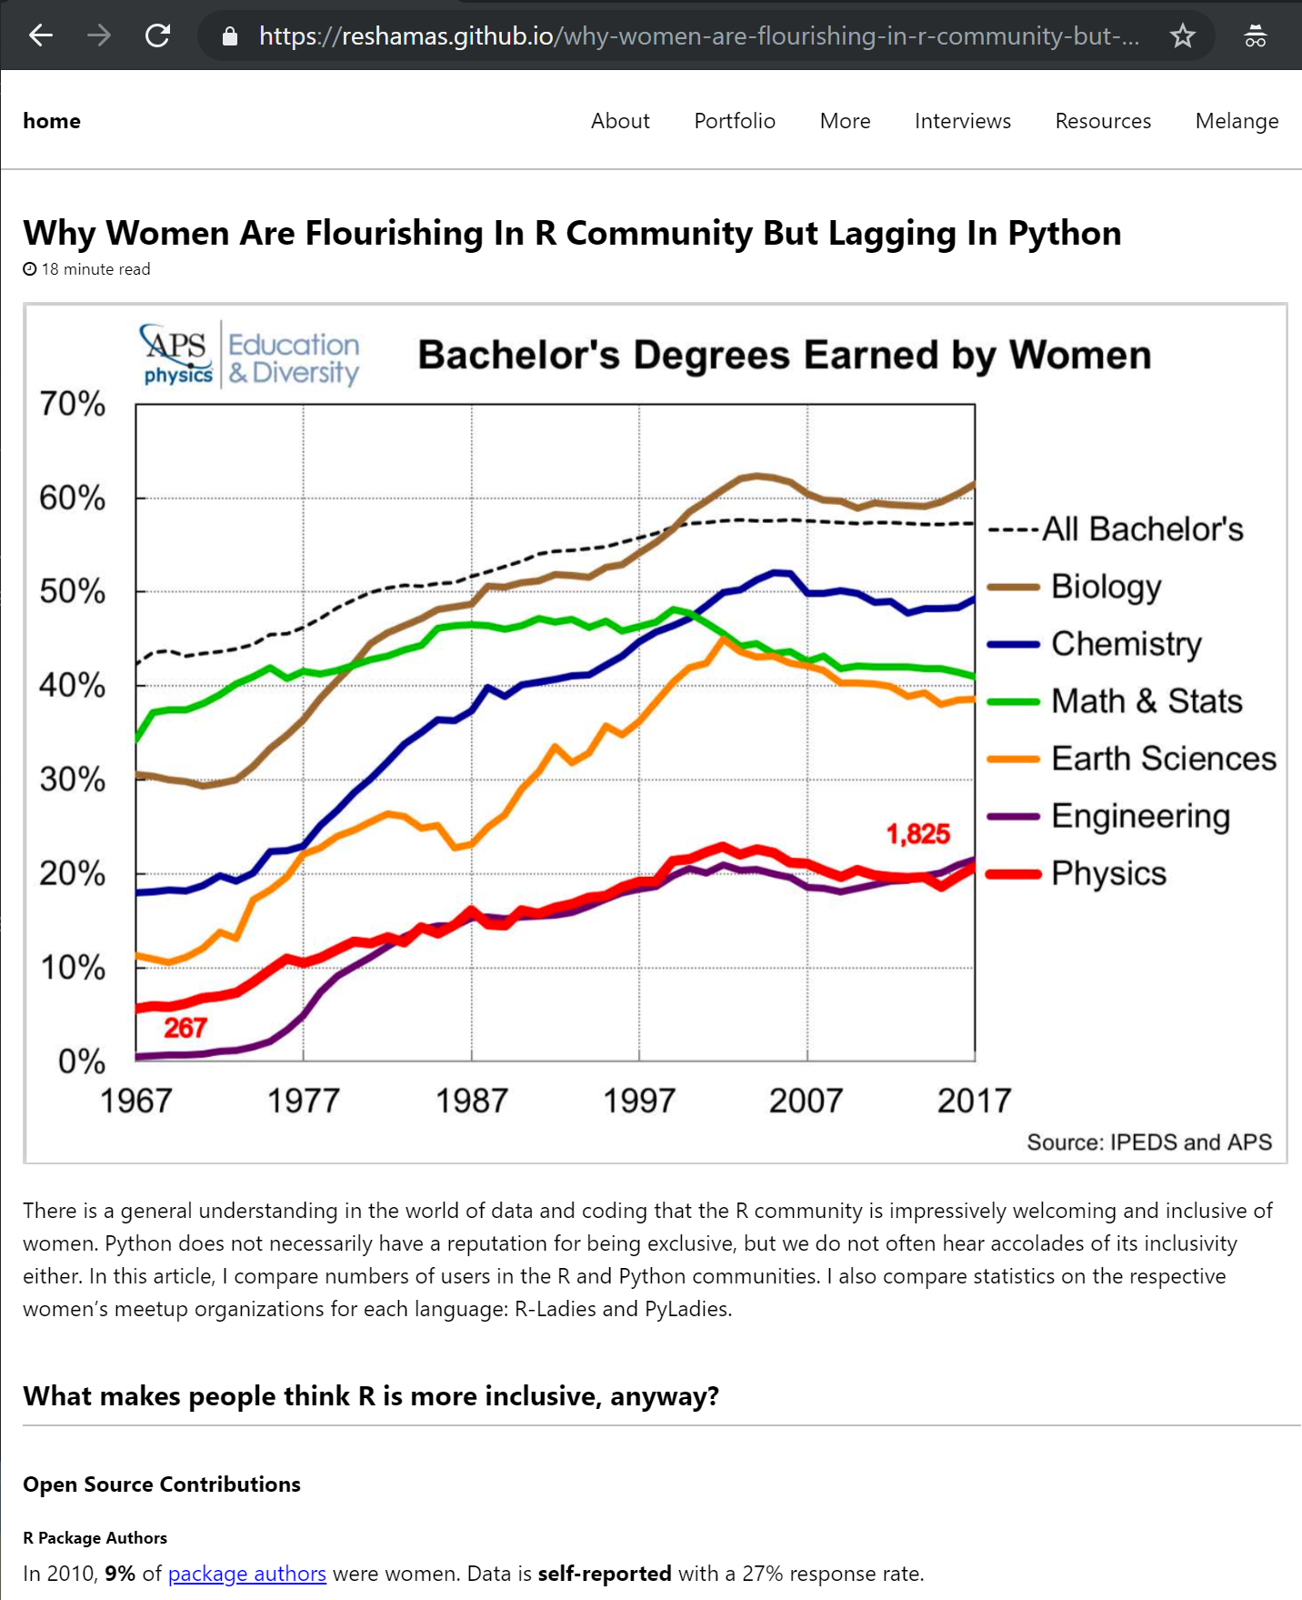
Comparing R and Python
Reshama Shaikh
bit.ly/2u5M0tV

Slide 8
Comparing R and Python
Community Size (StackOverflow 2018 developer survey)
Python: 38.8%
R: 6.1%
Womens’ User Groups
R-Ladies: 29,500 members
PyLadies: 36,500 members
GitHub contributors:
R: 9.3% women
Python: 2% women
Reshama Shaikh
bit.ly/2u5M0tV

Slide 9
R-Ladies
San Francisco, CA
October 2012

Slide 10
R-Ladies
Worldwide organization that promotes diversity in the #rstats community via meetups and mentorship in a friendly and safe environment.

Slide 11
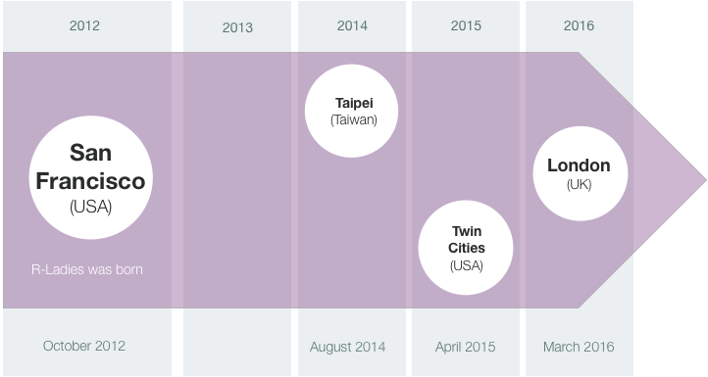
R-Ladies

Slide 12
R-Ladies
San Francisco and London meet and get together to create …

Slide 13
The R-Ladies Global!
Gabriela de Queiroz
Erin LeDell
Claudia Vitolo​
Hannah Frick
Alice Daish
Rachel Kirkham
Chiin-Rui Tan
Heather Turner
#rdogladies

Slide 14
August, 2016
R-Ladies is awarded $10,000
to establish additional
R-Ladies groups worldwide

Slide 15
One of our Goals (related to expansion)
Expand to 5-10 cities within the next year

Slide 16
R-Ladies Growth
(2016 - Feb 2018)
2016
2017
Feb, 2018
Feb, 2018
2
10 new groups
20 new groups
48 new groups
10 new groups
81 chapters
23 chapters
71 chapters
81 chapters

Slide 17
Q4 of 2017
R-Ladies makes a
new proposal for funding

Slide 18
R-Ladies becomes top level
March, 2018
R-Ladies gets long term support
(3 years)
https://www.r-consortium.org/announcement/2018/03/27/r-consortium-welcomes-r-ladies-as-a-top-level-project

Slide 19
R-Ladies Growth
(March 2019)
45+ countries
145+ cities
42,000+
members

Slide 20
R-Ladies around the world
8 Canada
46 Europe
44 USA
6 Asia
5 Africa
29 Latin America
7 Australia + NZ

Slide 21
One Story about R-Ladies’ Impact

Slide 22
A Cautionary Tale

Slide 23
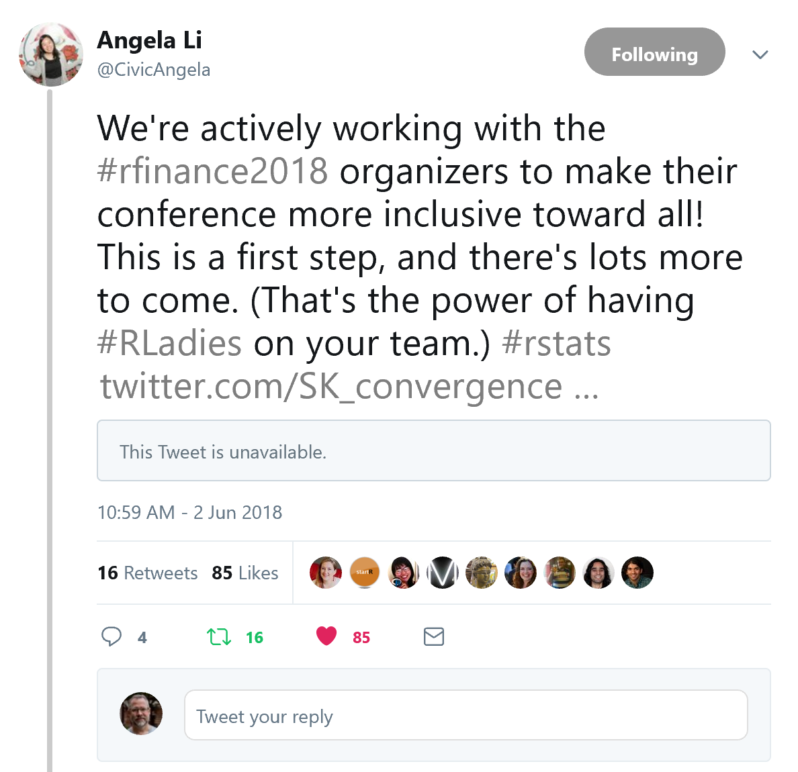
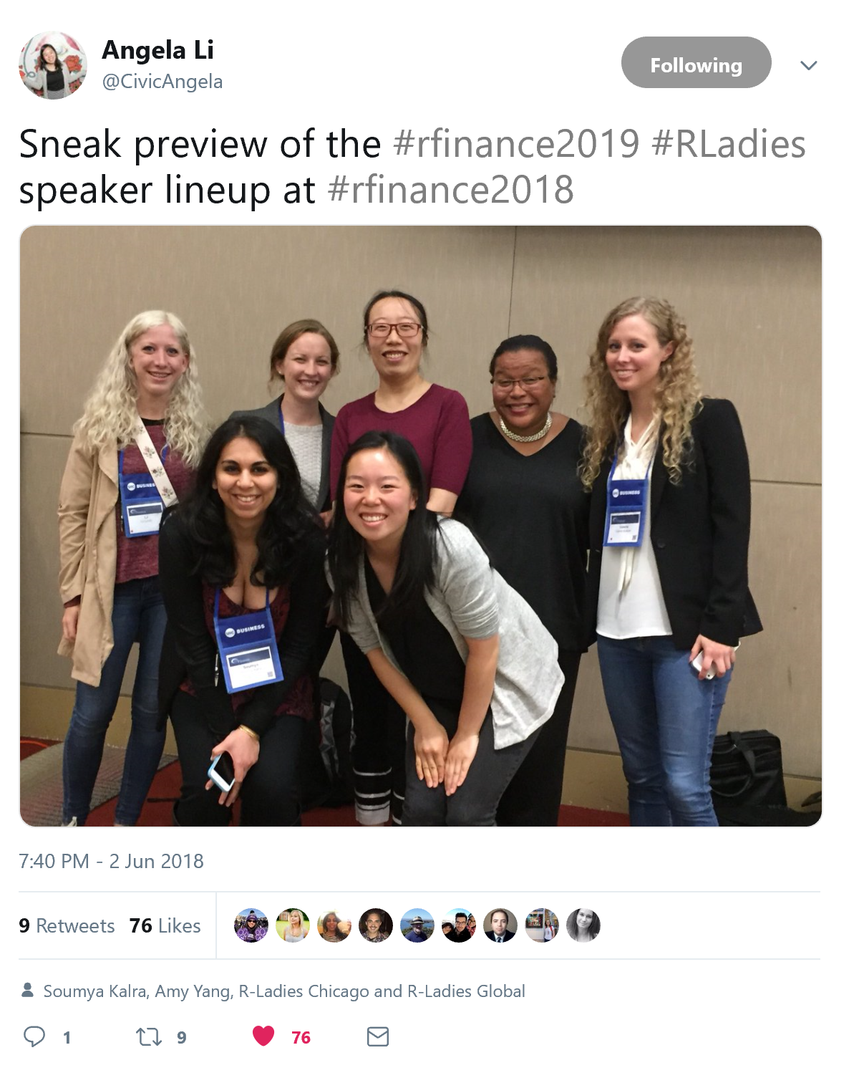
Helping to improve

Slide 24
Conclusions
In healthy communities, change is possible.
R-Ladies has had a huge impact on the R community
A focus on diversity helps open-source communities grow and thrive.
A grass-roots approach works. Support diversity organizations within your community.

Slide 25
Thank you!
David Smith
@revodavid
Director, R Consortium
Cloud Advocate, Microsoft
Gabriela de Queiroz
@gdequeiroz
Founder, R-Ladies (rladies.org)
Senior Developer Advocate, IBM

